Slide 1
A Better Me!
CDR Valarie T. Gardner, LCSW, MAC, BCD
Deputy WL

Slide 2
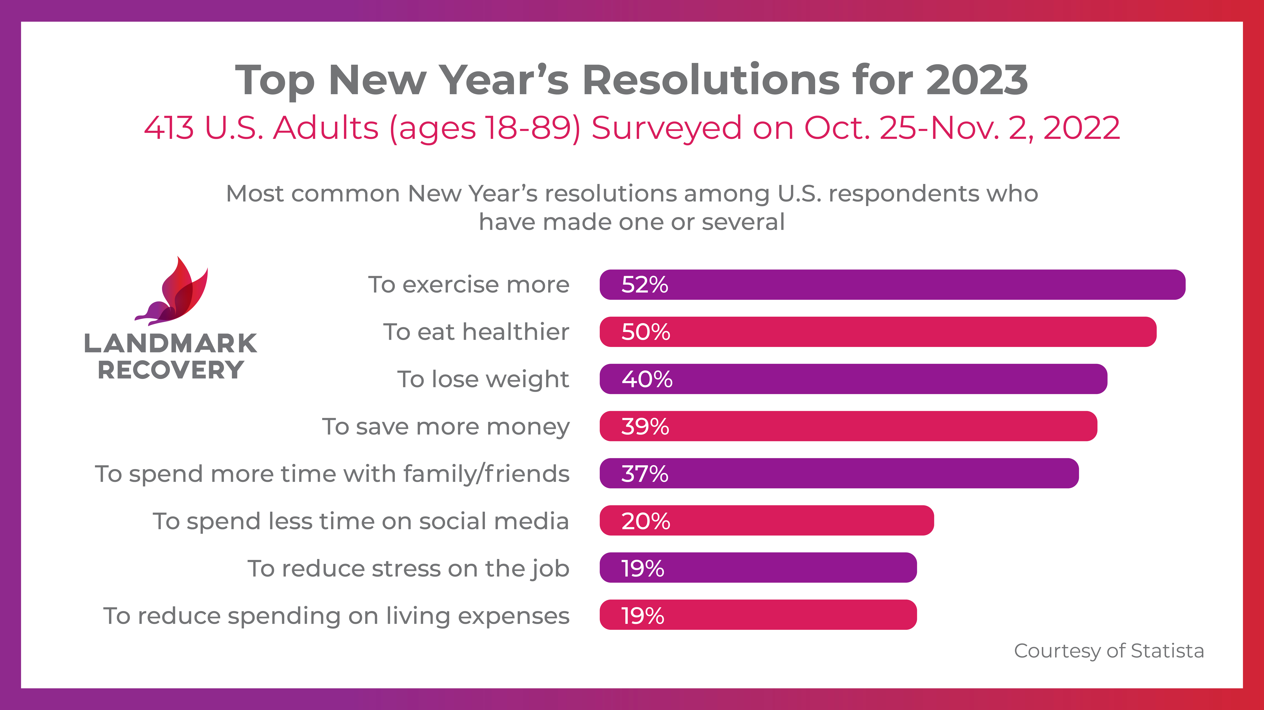
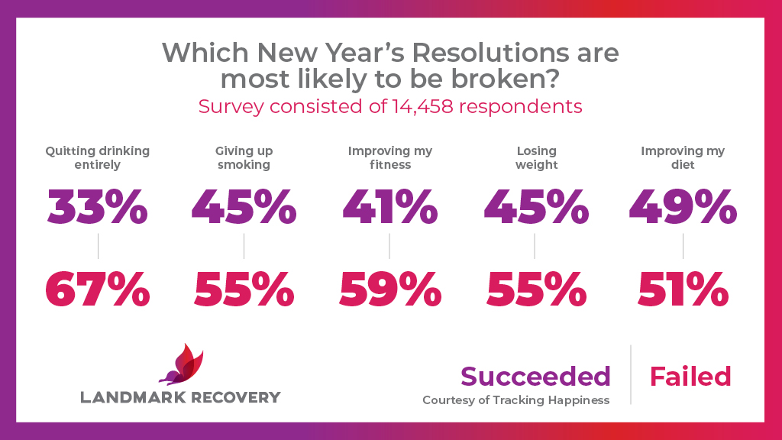
Interesting Facts – New Year’s Resolutions
New Year's Resolutions for 2023 were nearly identical to 2022, 2021, 2020, and so on!
80% of people fail to keep their resolutions by February!
https://time.com/6243642/how-to-keep-new-years-resolutions-2/

Slide 4
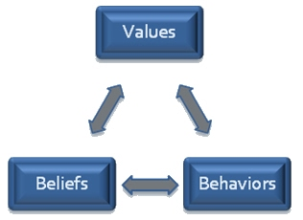
WHAT IS YOUR WHY?
Values are not goals in that we never “accomplish” a value. Instead, “Values are like a compass–they help us make choices based on the directions in which we want our lives to go. Values are who we want to be and what we want our lives to be about. When we connect with our values, we are able move our lives in meaningful directions, even in the face of difficult or painful experiences”. Steven Hayes, ACT Therapy

Slide 5
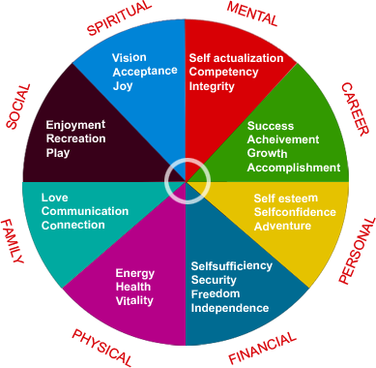
WHAT Is Your Why?
What do you Value Most?
Notes:
Brief Exercise
Top Three
How much time?
Where do you spend most of your energy?

Slide 6
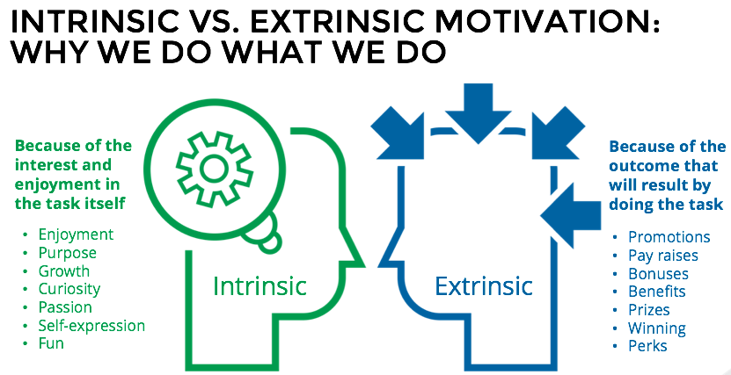
WHAT IS YOUR WHY?

Slide 7
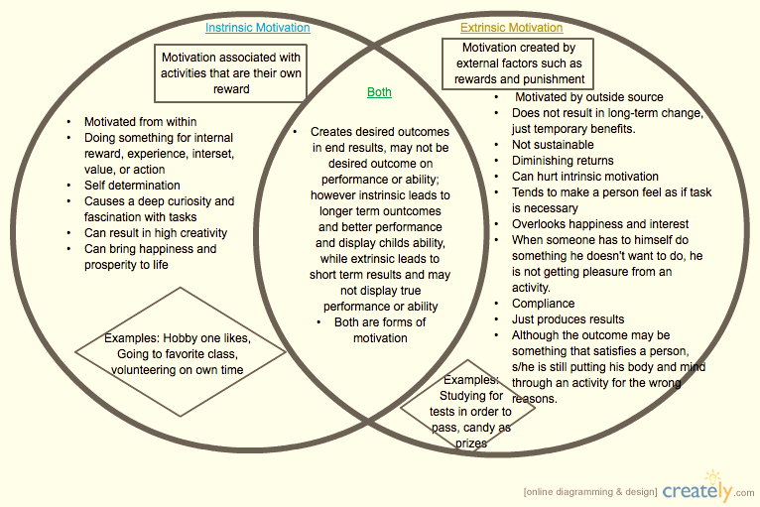
WHAT IS YOUR WHY?

Slide 8
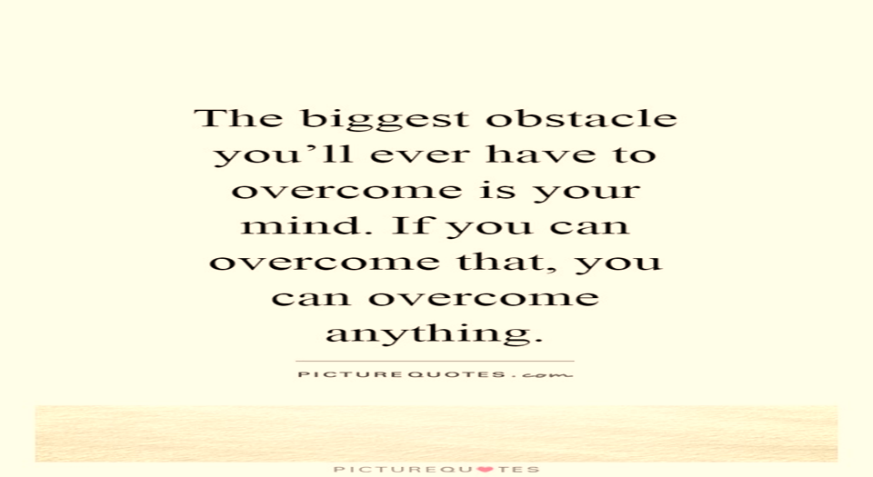
WHAT ARE THE OBSTACLES GETTING IN YOUR WAY?
Internal Obstacles – Created by you or your reaction to an externals events.
External Obstacles – Caused by something or someone else.

Slide 9
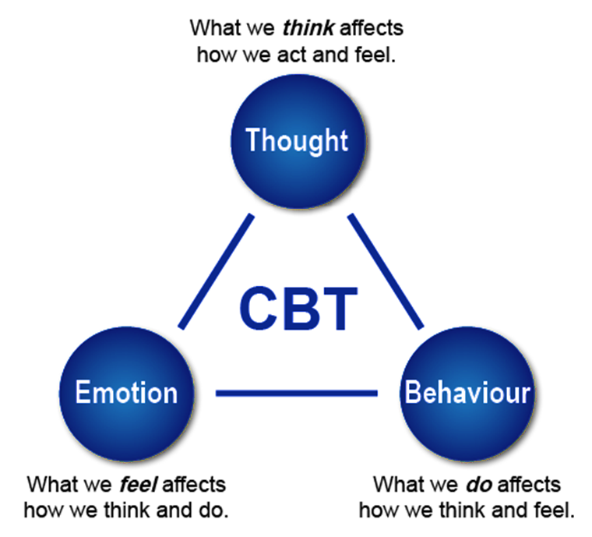
WHAT ARE THE OBSTACLES GETTING IN YOUR WAY?
Cognitive Behavior Therapy

Slide 10
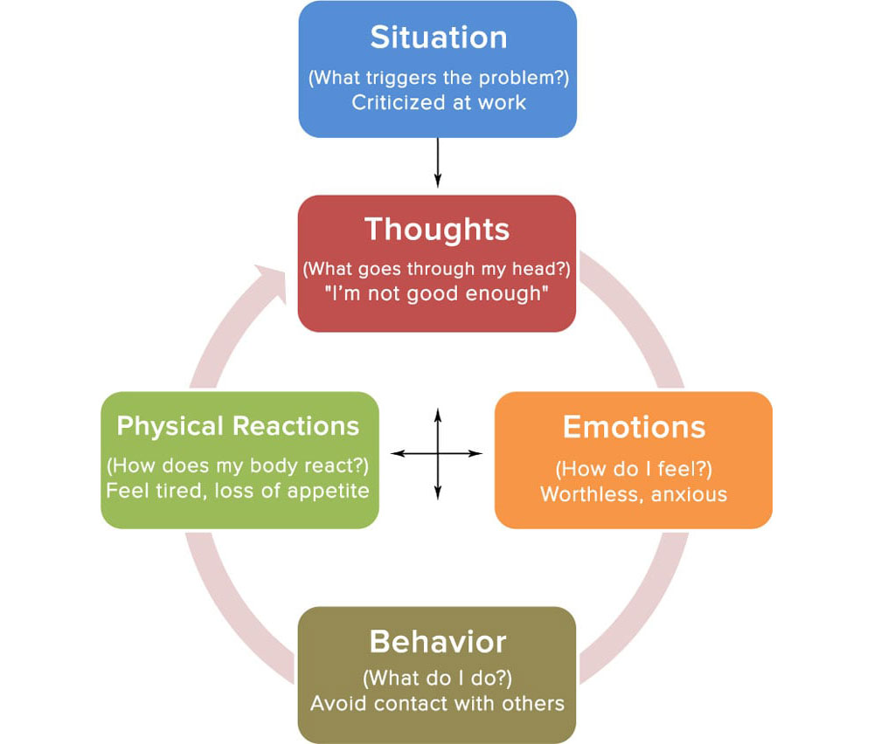
WHAT ARE THE OBSTACLES GETTING IN YOUR WAY?
*Souce:https://www.online-therapy.com/blog/wp-content/uploads/2014/01/cbt@2x-1.jpg

Slide 11
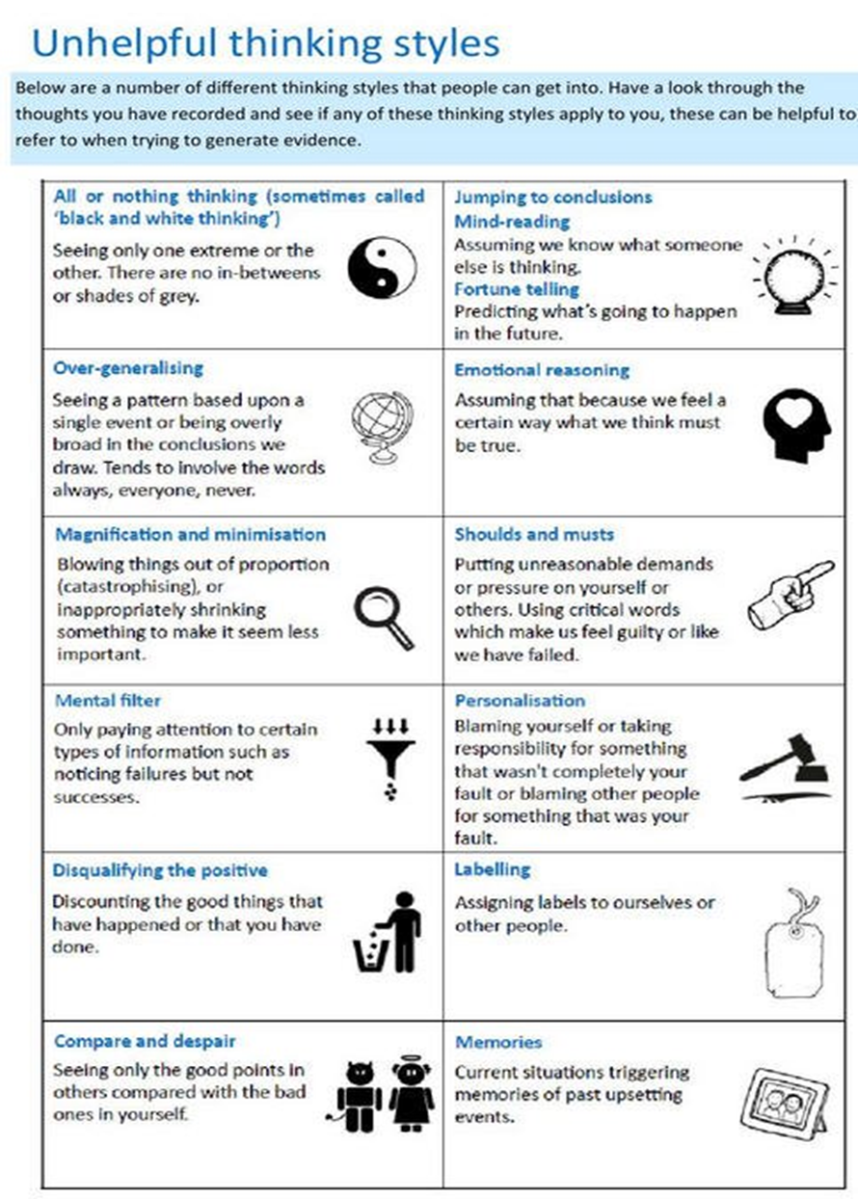
WHAT ARE THE OBSTACLES GETTING IN YOUR WAY?

Slide 12
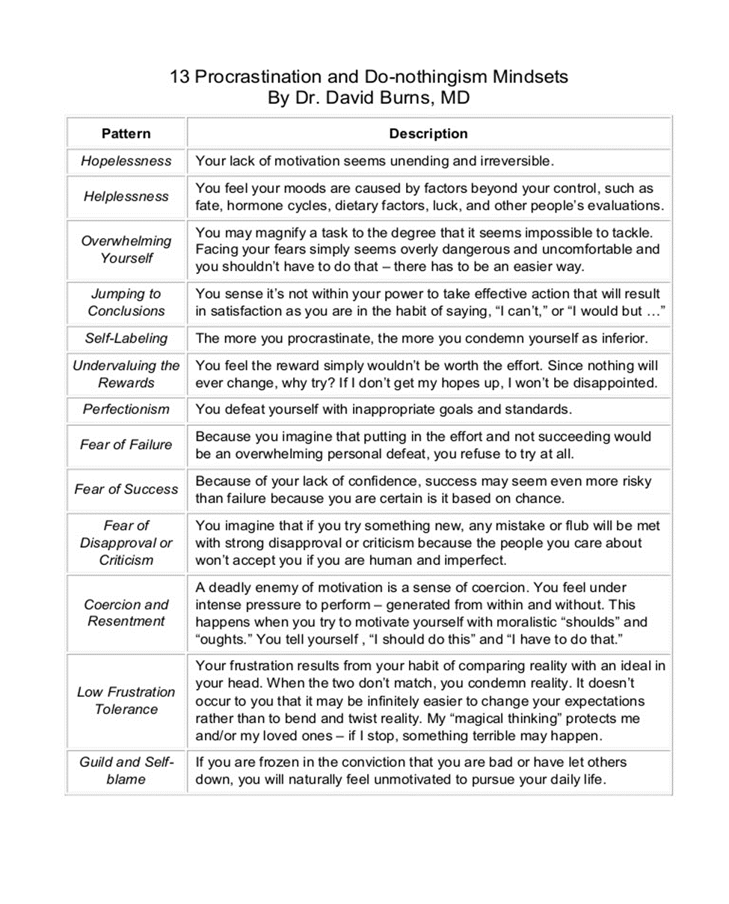
WHAT ARE THE OBSTACLES GETTING IN YOUR WAY?

Slide 13
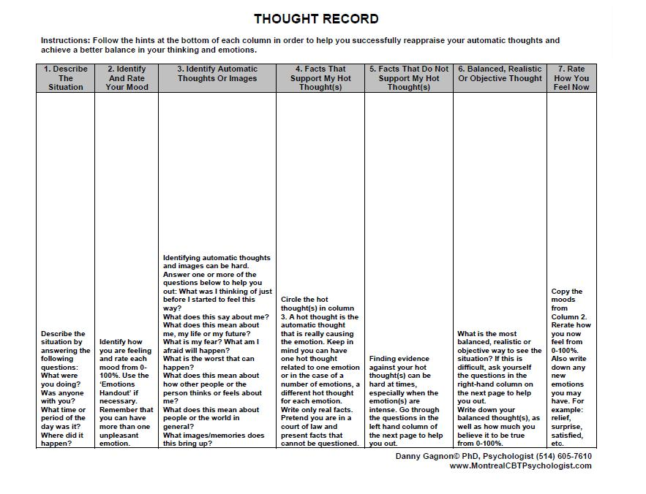
WHAT ARE THE OBSTACLES GETTING IN YOUR WAY?
*Souce:mindovermood.com

Slide 14
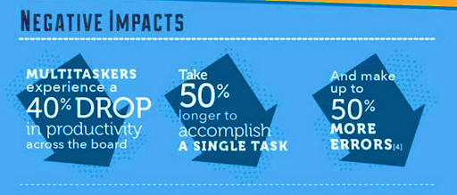
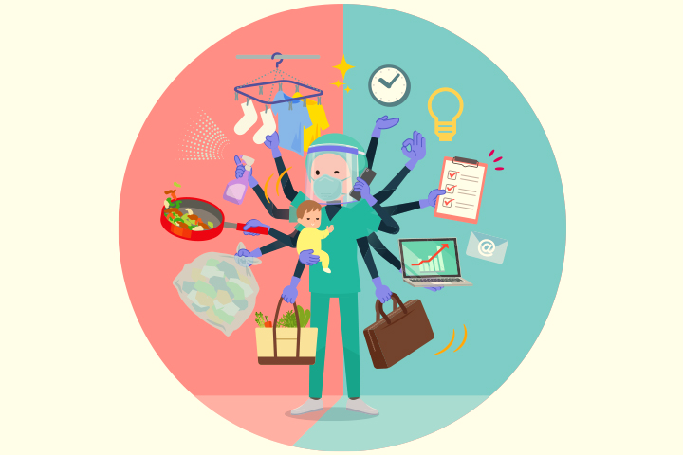
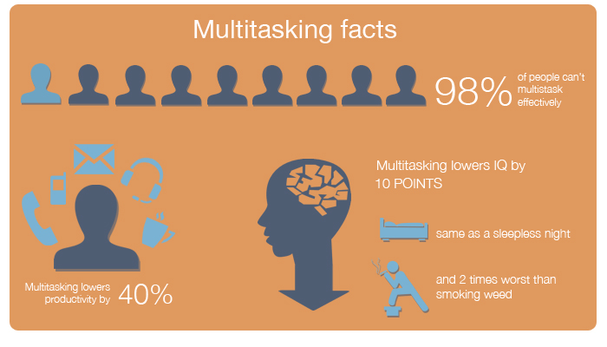
WHAT ARE THE OBSTACLES GETTING IN YOUR WAY?
MULTI-TASKING LEADS TO BRAIN OVERLOAD
Source: http://pivotchange.com/negative-impact-of-multitasking-1024x438small/
Source: https://www.weforum.org/agenda/2018/09/the-science-of-multitasking-and-why-you-should-doodle-in-class

Slide 15
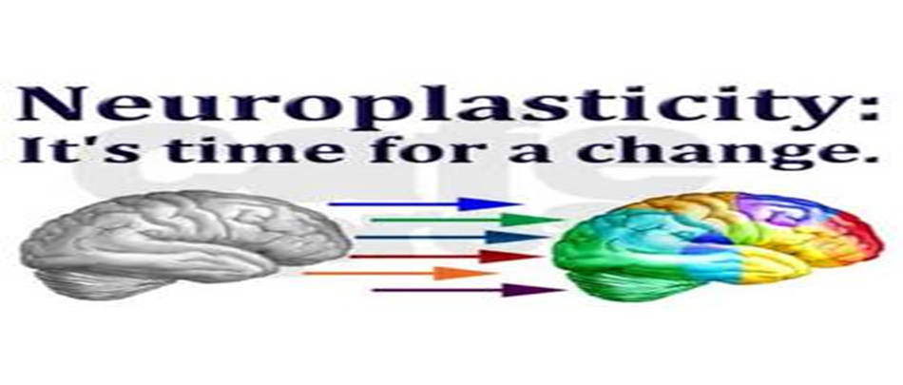
WHAT IS YOUR ACTION PLAN?
Change…it’s never to late!
Neuroplasticity: The brain's ability to reorganize itself by forming new neural connections throughout life.
https://www.youtube.com/watch?v=ELpfYCZa87g

Slide 16
WHAT IS YOUR ACTION PLAN?
Neuroplasticity – Habit Formation
In previous generations, people often believed that the neural connections of the brain were fixed by a certain age.
We now know that the brain continues to develop and rewire itself throughout life and that experience can change the brain’s structure and functioning.
The ability to learn new coping skills and habits is an important part of neuroplasticity. (30-60 times to practice)

Slide 17
WHAT IS YOUR ACTION PLAN?
Decrease Brain Overload:
Externalize
Simplify
Mindfulness

Slide 18
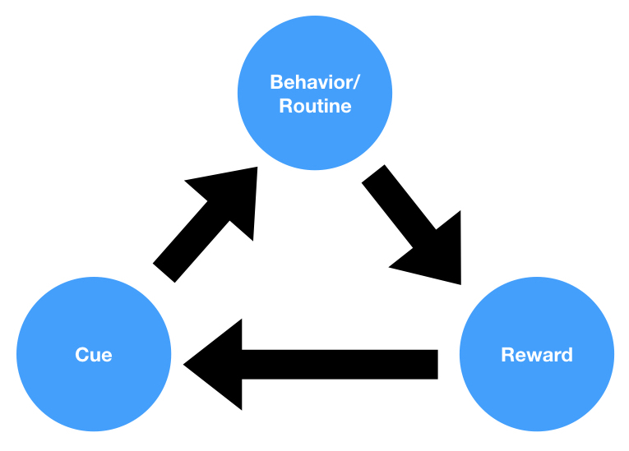
WHAT IS YOUR ACTION PLAN?
+
=
Identity (My Why)
Awareness
(Mindfulness)
Behaviors
(New Habits)

Slide 19
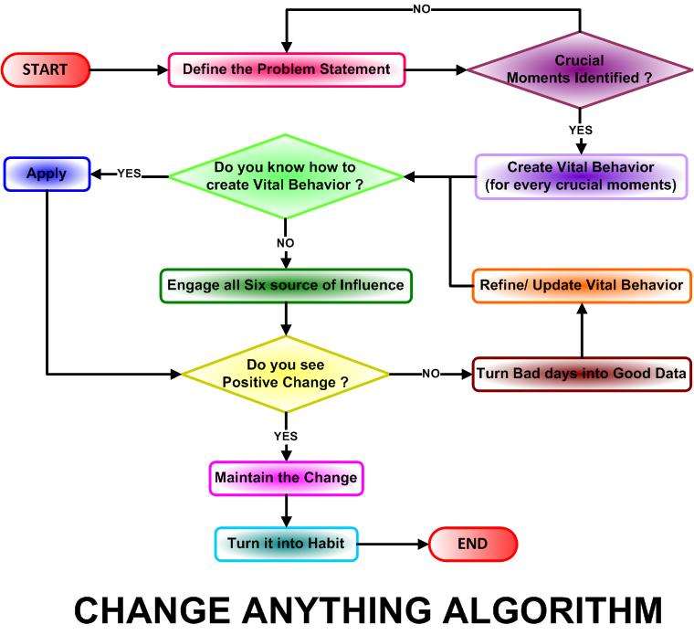
WHAT IS YOUR ACTION PLAN?

Slide 20
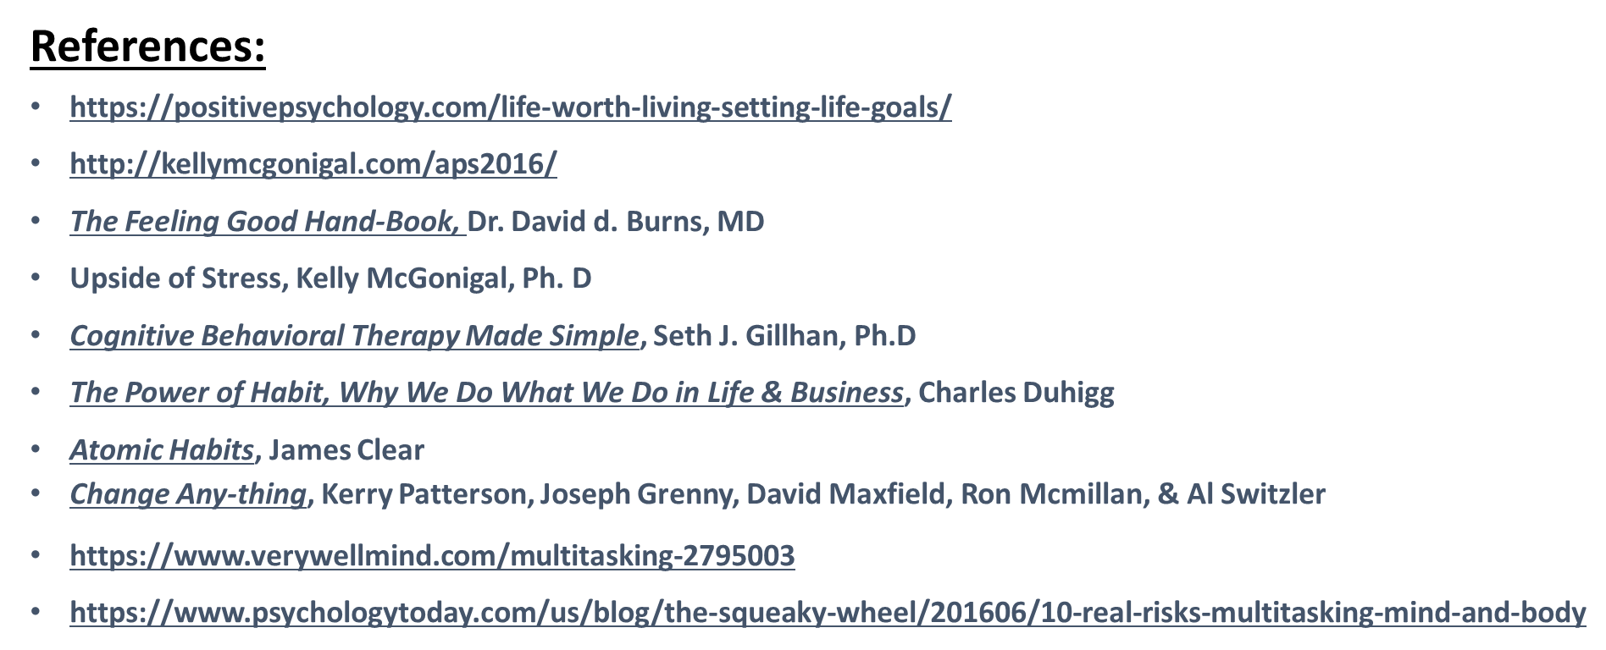
Discussion/ Q&A

